Slide 1
Demand Management
MCWRA-SVBGSA Joint Workshop on Groundwater Sustainability
May 18, 2026 | Integrated Implementation Strategy
Monterey County Water Resources Agency & Salinas Valley Basin Groundwater Sustainability Agency

Slide 2
Project Overview
Demand Management considers reducing groundwater pumping to balance water budgets and complement supply-side projects by closing the gap between supply and demand. It emphasizes incentive-based approaches as an early implementation step, with priority development of mandatory measures in areas where consequences of inaction are most severe.
MCWRA-SVBGSA Joint Workshop | May 18, 2026 | Demand Mgmt
Integrated Implementation Strategy

Slide 3
Scenarios Evaluated
1
Voluntary Incentive Programs
2
Mandatory Measures: Priority Areas
3
Mandatory Measures:
Larger Scope
Financial incentives for water efficiency
Technical assistance and outreach
Near-term implementation possible
Uncertain uptake rates
Focused on SWI and Deep Aquifer overlap
Pumping allocations or caps
Requires robust metering/monitoring
Significant stakeholder engagement needed
To achieve GWL minimum thresholds without projects aggregate 9-14% ag pumping reductions are required
180/400: 18%-36%
Eastside: 17-25%
Forebay: 4.5-9%
MCWRA-SVBGSA Joint Workshop | May 18, 2026 | Demand Mgmt
Integrated Implementation Strategy

Slide 4
Key Findings
✓
Select voluntary and mandatory measures can be deployed; mandatory measures need further evaluation
✓
Prioritizing development of programs/policies for seawater intruded area and overlapping Deep Aquifers
✓
Pumping reductions raise groundwater levels but do not achieve SWI minimum threshold alone
✓
Most effective when paired with supply projects
✓
To achieve GWL minimum thresholds in 3 subbasins 41,000 – 61,000 AFY pumping reductions is required
✓
MCWRA-SVBGSA Joint Workshop | May 18, 2026 | Demand Mgmt
Integrated Implementation Strategy

Slide 5
Cost Estimates
TBD (program development)
TBD (monitoring and enforcement)
TBD
Capital Cost
Annual O&M Cost
Unit Cost
Ag pumping reductions of 41,000-61,000 AFY (9%-14%) result in annual
Gross revenue loss of $505-$717M
Output value loss of $1.358B-$1.932B
MCWRA-SVBGSA Joint Workshop | May 18, 2026 | Demand Mgmt
Integrated Implementation Strategy

Slide 6
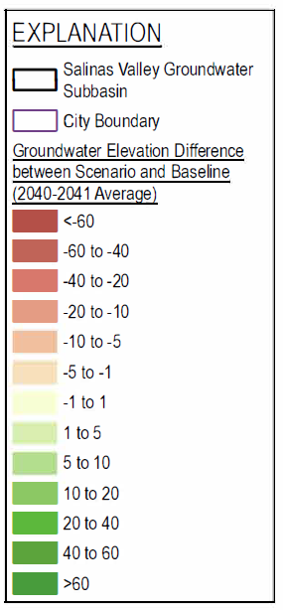
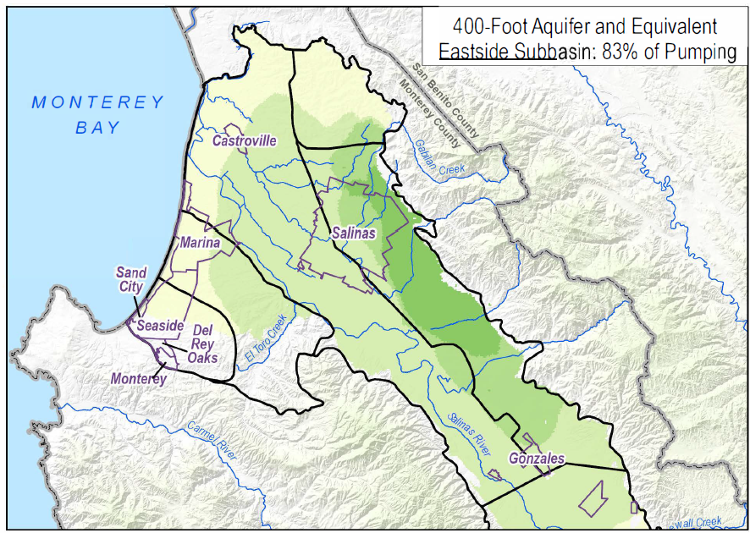
Effectiveness: Groundwater Levels – Eastside Subbasin
Groundwater Levels
Direct reduction in pumping raises groundwater levels
Benefits concentrated in areas where pumping is reduced
Complements other PMAs by reducing the supply gap
MCWRA-SVBGSA Joint Workshop | May 18, 2026 | Demand Mgmt
Integrated Implementation Strategy

Slide 7
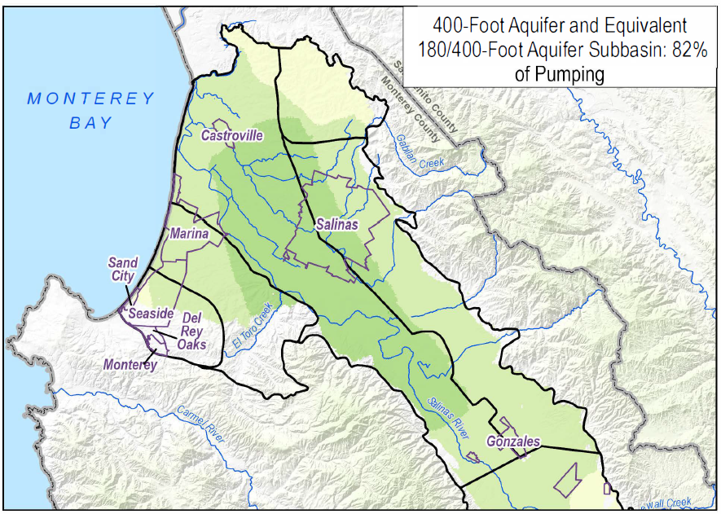
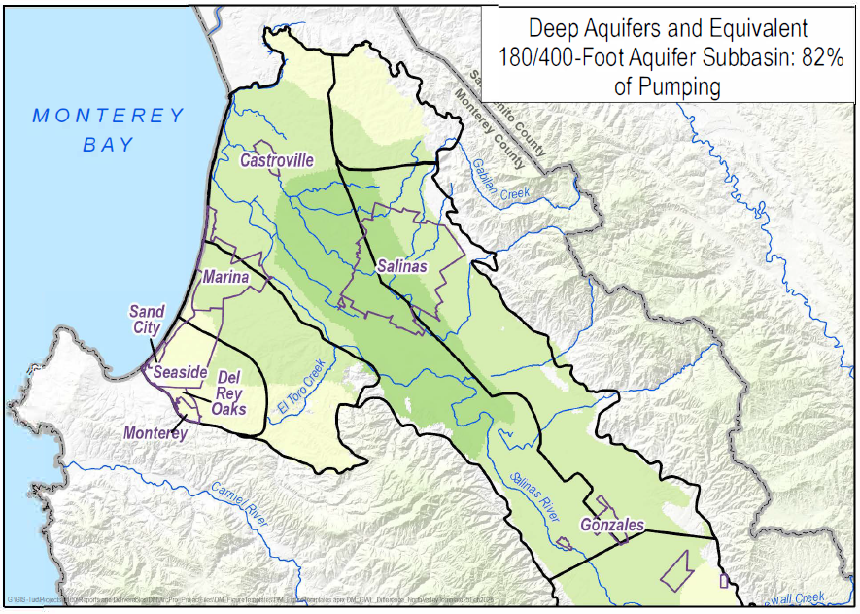
Effectiveness: Groundwater Levels – 180/400 Subbasin
Groundwater Levels
MCWRA-SVBGSA Joint Workshop | May 18, 2026 | Demand Mgmt
Integrated Implementation Strategy

Slide 8
Questions & Discussion
Piret Harmon
General Manager, SVBGSA
harmonp@svbgsa.org
MCWRA-SVBGSA Joint Workshop | May 18, 2026 | Demand Mgmt
Integrated Implementation Strategy

