Slide 1
Castroville Seawater Intrusion Project (CSIP) Optimization
MCWRA-SVBGSA Joint Workshop on Groundwater Sustainability
May 18, 2026 | Integrated Implementation Strategy
Monterey County Water Resources Agency & Salinas Valley Basin Groundwater Sustainability Agency

Slide 2
Project Overview
The CSIP Optimization Project enhances the existing Castroville Seawater Intrusion Project distribution system to increase recycled and surface water deliveries and reduce groundwater pumping from supplemental wells. Implemented by MCWRA in partnership with Monterey One Water, the project addresses seawater intrusion in the 180/400-Foot Aquifer Subbasin through hydraulic modeling, system upgrades, and capital improvement projects. This follows a phased approach that is incrementally providing enhancements to CSIP.
MCWRA-SVBGSA Joint Workshop | May 18, 2026 | CSIP Optimization
Integrated Implementation Strategy

Slide 3
Project Phases
1
Phase 1: Completed Projects
2
Phase 2: Identified Improvements
3
Phase 3: Future Enhancements
Reduce recycled water plant maintenance shutdowns: Chlorination Facility Dry Scrubber upgrade
Increase system pressure: Booster station enhancements
Align system demand with available non-groundwater sources: Water scheduling program
Improve effectiveness of boosters to increase pressure: Valves installation
Increase system conveyance and redundancy: 2nd pond outlet
Provide access to available non-groundwater supplies during peak demand periods: Adding storage capacity
Further evaluate the system and make operational and physical improvements that eliminate the reliance on groundwater pumping and provide reliable in-lieu supplies to the existing service area.
MCWRA-SVBGSA Joint Workshop | May 18, 2026 | CSIP Optimization
Integrated Implementation Strategy

Slide 4
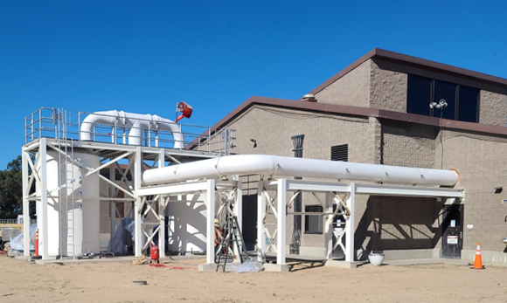
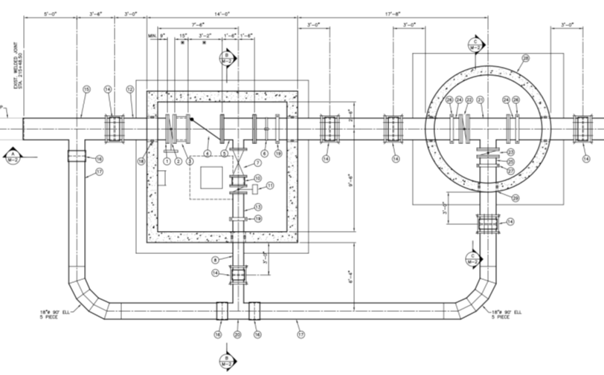
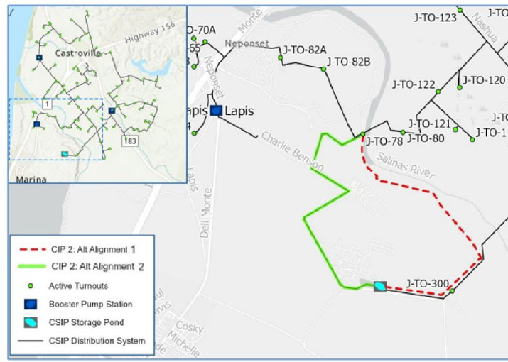
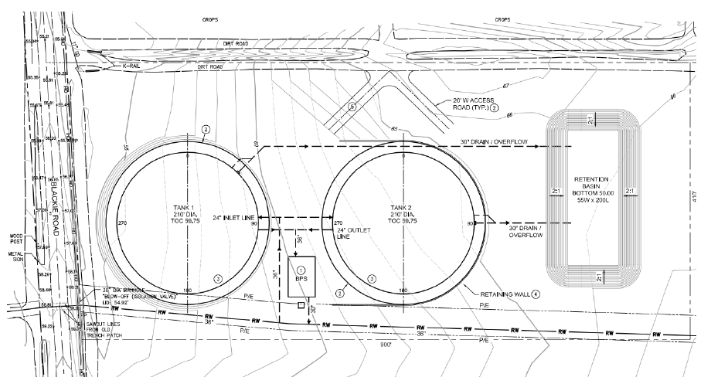
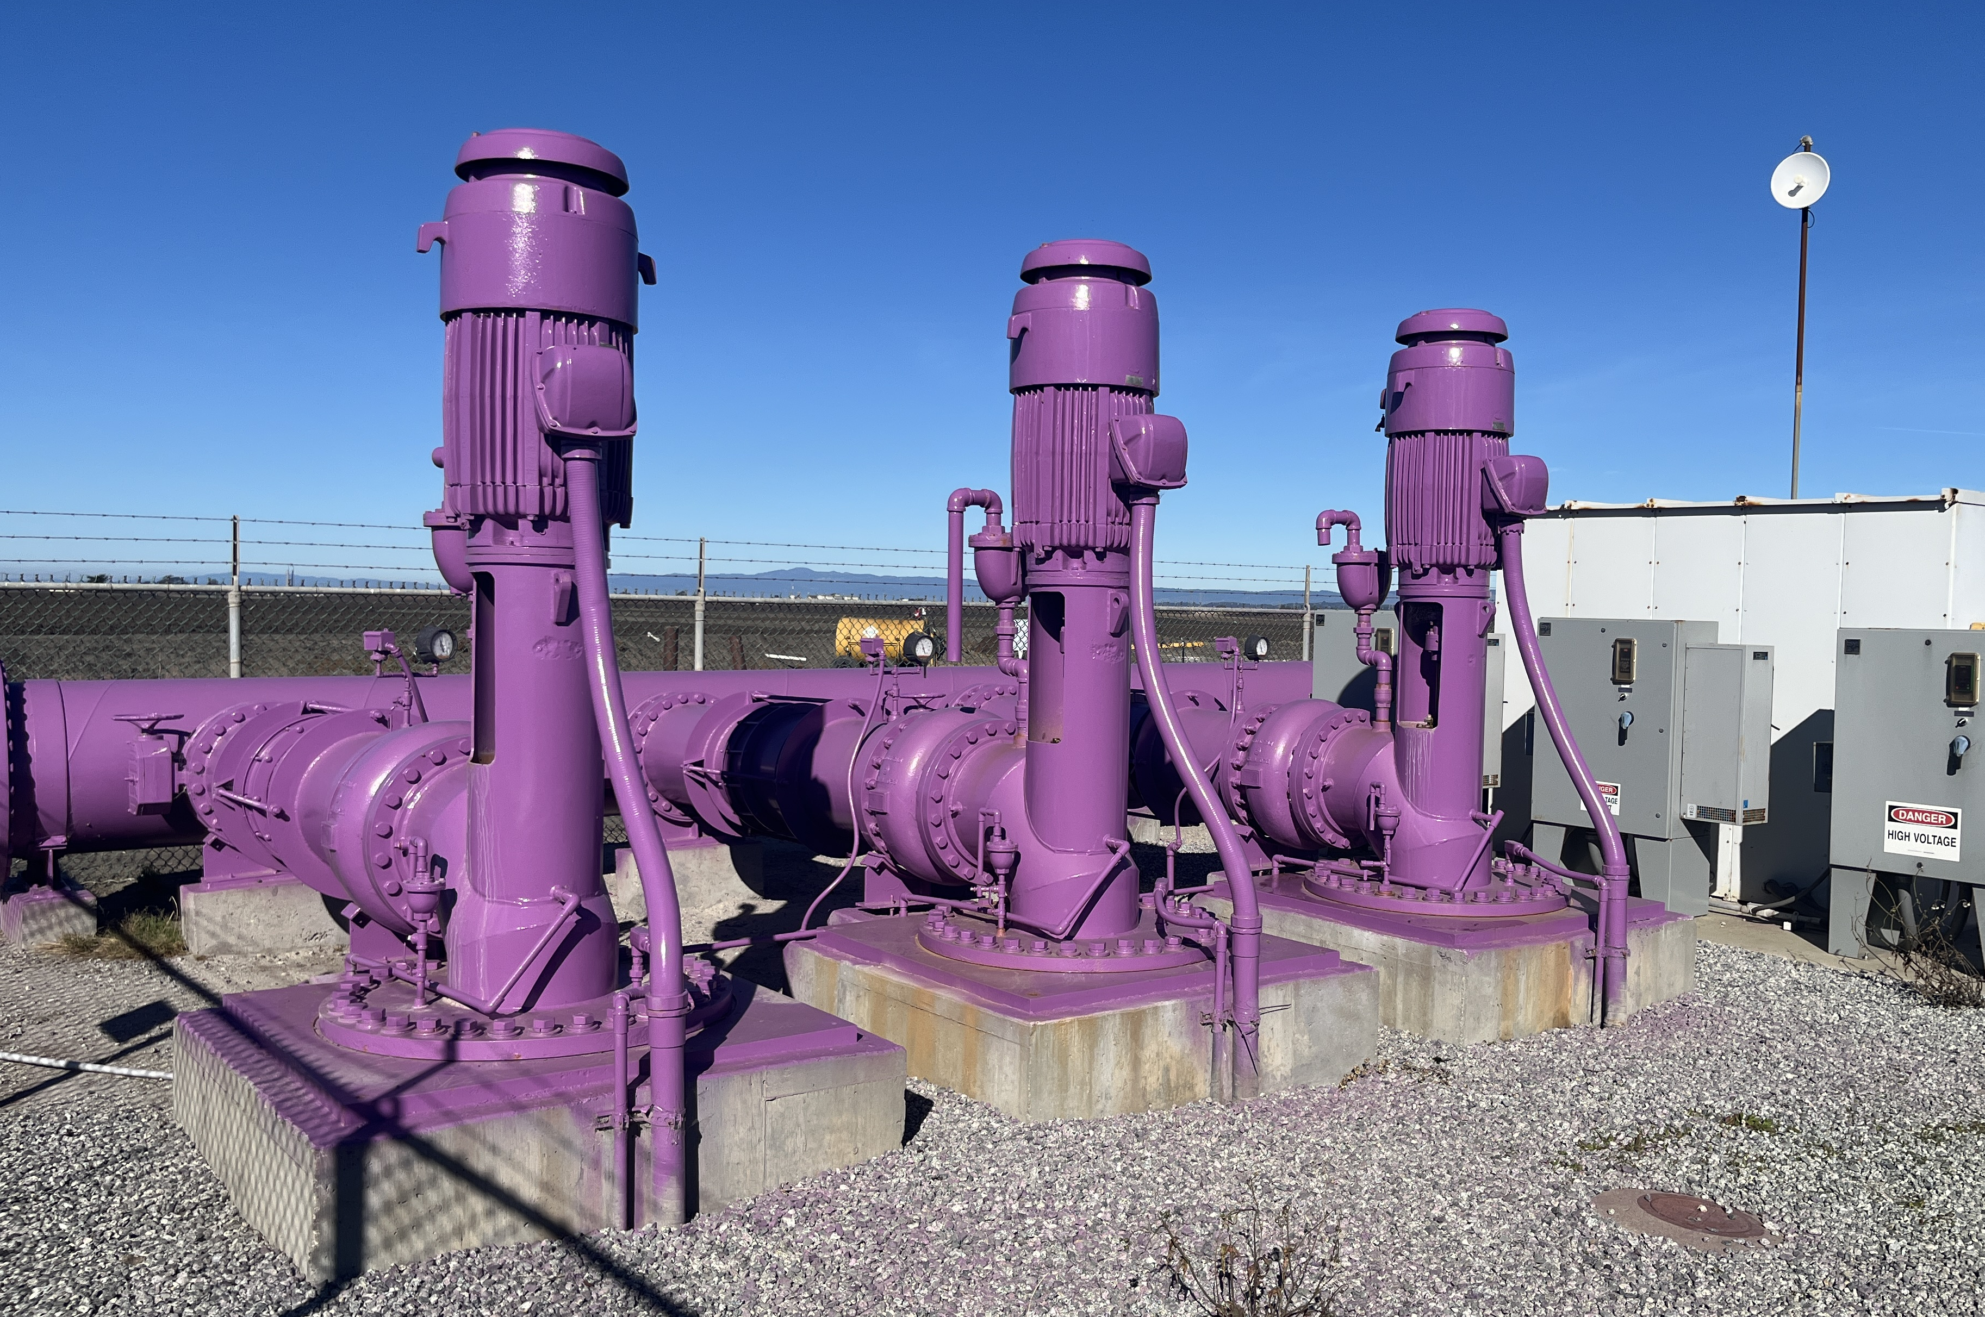
8) How does the bid process work, where will it be held at.
CSIP Optimization
Phase 2: Pipeline enhancements & storage facilities
Phase 1: Dry Scrubbers & Booster Pumps
MCWRA-SVBGSA Joint Workshop | May 18, 2026 | CSIP Optimization
Integrated Implementation Strategy

Slide 5
Key Findings
✓
Identified Capital Improvement Projects (CIPs) to address system hydraulic constraints that are currently addressed using groundwater pumping
✓
CSIP modeling identified supply head and conveyance constraints, need for 10-12.5 million gallons of additional storage, system redundancy and reliability
✓
Most shovel-ready project: some design complete, minimal permitting and environmental review needed
✓
Enhancements each provide incremental benefit and can be phased in over time
✓
Identified CIPs can reduce supplemental well pumping 248 AFY to 1,625 AFY
MCWRA-SVBGSA Joint Workshop | May 18, 2026 | CSIP Optimization
Integrated Implementation Strategy

Slide 6
Cost Estimates for Phase 2
$60.6M
TBD
TBD
Capital Cost
Annual O&M Cost
Unit Cost
Cost Components
CIP 1: $650k (Hydraulic pipeline upgrades)
CIP 2: $26.2M (Storage pond enhancements)
CIP 3: $33.7M (Storage and system upgrades)
MCWRA-SVBGSA Joint Workshop | May 18, 2026 | CSIP Optimization
Integrated Implementation Strategy

Slide 7
Questions & Discussion
Shaunna Murray
Deputy General Manager, MCWRA
murraysl@countyofmonterey.gov
MCWRA-SVBGSA Joint Workshop | May 18, 2026 | CSIP Optimization
Integrated Implementation Strategy

