Slide 1
Castroville & Eastside Canals and Alternatives (C&E)
MCWRA-SVBGSA Joint Workshop on Groundwater Sustainability
May 18, 2026 | Integrated Implementation Strategy
Monterey County Water Resources Agency & Salinas Valley Basin Groundwater Sustainability Agency

Slide 2
Project Overview
Using Salinas River water - primarily under MCWRA's Water Right Permit 11043 - to address four groundwater sustainability goals:
Raise GW levels in central/southern Eastside and 180/400 Subbasins
Raise GW levels in northern Eastside
Stop seawater intrusion
Support groundwater recovery in the Deep Aquifers.
MCWRA-SVBGSA Joint Workshop | May 18, 2026 | C&E Canals
Integrated Implementation Strategy

Slide 3
Scenarios Evaluated
1
Eastside Recharge Basins
2
Northern Eastside Injection
Divert Salinas River to recharge basins
50, 100, 200, and 400 cfs scales evaluated
Most cost-effective scenario
Broadest geographic GW benefit
50 cfs with Merritt Lake storage
100 cfs with new Gabilan Reservoir
Targets GW depression near Salinas
Benefits propagate to adjacent subbasins
3
Coastal Injection
4
NSIP Concept
Targets 400-Ft Aquifer SWI
50 cfs diversion capacity
Modest SWI reduction; does not meet MT
Could combine with other efforts
Direct surface water delivery
Replace GW pumping in Deep Aquifers/SWI area
Constrained by Merritt Lake storage
Evaluated separately as standalone PMA
MCWRA-SVBGSA Joint Workshop | May 18, 2026 | C&E Canals
Integrated Implementation Strategy

Slide 4
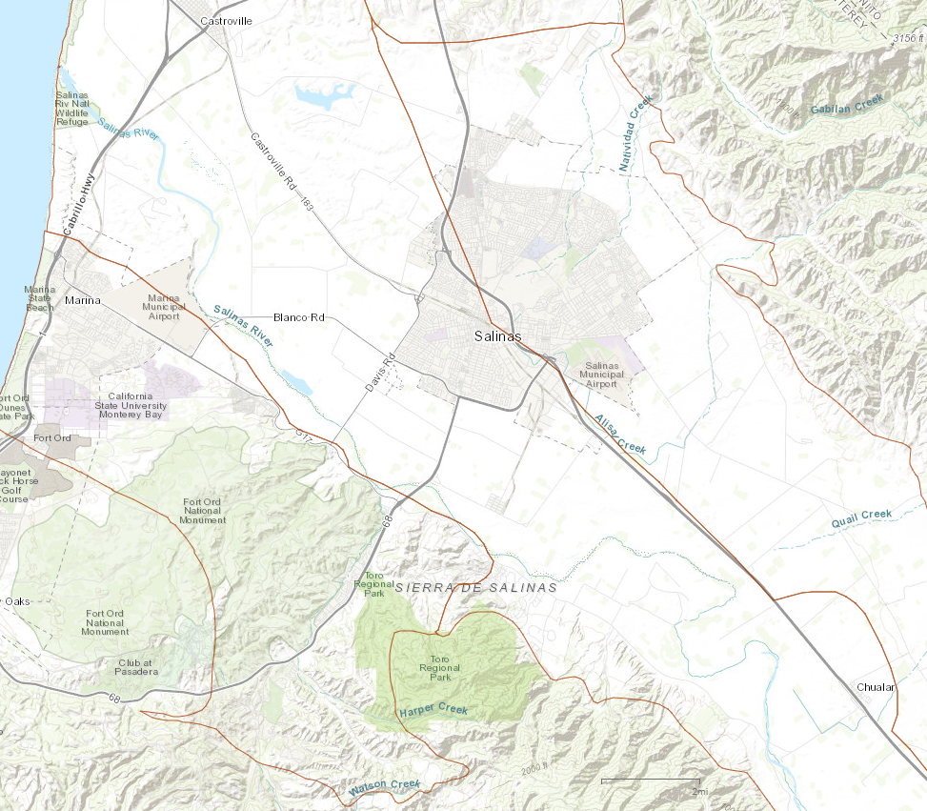
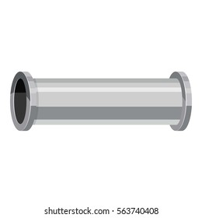


Project: Visual Summary
Project Scenarios
Northern Eastside Injection
  50 cfs with storage at Merritt Lake
  100 cfs with storage in new Gabilan Reservoir
Eastside Recharge Basins
  50 cfs
  100 cfs
  200 cfs
  400 cfs
Coastal Injection (not shown)
NSIP (not shown)
Northern Eastside Injection Wells
Surface Water Storage and Water Treatment Plant (or location to the West)
Salinas River
Eastside Recharge Basins
MCWRA-SVBGSA Joint Workshop | May 18, 2026 | C&E Canals
Integrated Implementation Strategy

Slide 5
Key Findings
✓
Can meaningfully contribute to sustainability goals, not sufficient to meet all of them alone
✓
Amendments to Permit 11043 would be required
✓
Eastside Recharge Basins provide the most cost-effective and geographically widespread benefits
✓
Injection-based projects offer targeted solutions where surficial recharge is not feasible
✓
Eight project alternatives evaluated with yields of 5,100 AFY-28,020 AFY
MCWRA-SVBGSA Joint Workshop | May 18, 2026 | C&E Canals
Integrated Implementation Strategy

Slide 6
Cost Estimates: Recharge Basins and Eastside Injection
R $140M-$1, 391M
I $516M-$1,017M
R $2 M-$24 M/yr
I $5-$10 M/yr
R $1,725-$3,246/AF
I $6,024-$6,232/AF
Capital Cost
Annual O&M Cost
Unit Cost
Cost Components
Diversion infrastructure
Surface water storage (Merritt Lake or new reservoir)
Recharge basins or injection well network
Water treatment facilities (for injection scenarios)
MCWRA-SVBGSA Joint Workshop | May 18, 2026 | C&E Canals
Integrated Implementation Strategy
Notes:
Recharge Basins Average yield
50 cfs 5,100 AF
100- 9,700
200- 17,200
400- 26,800

Slide 7
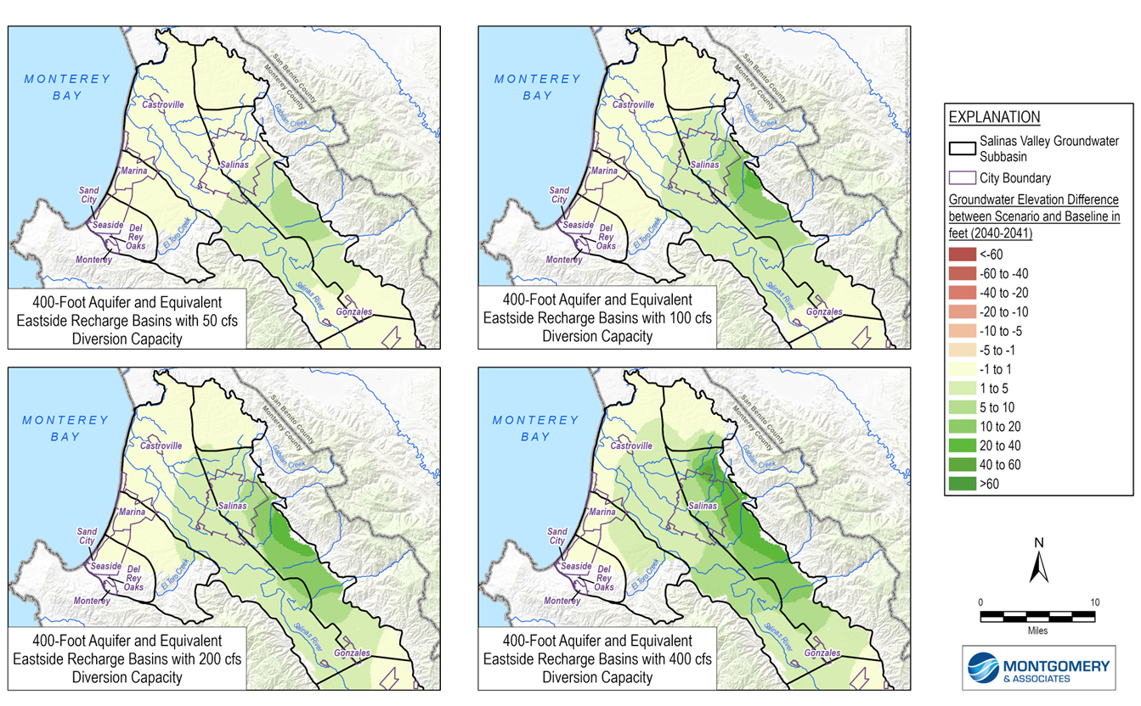
Effectiveness: Groundwater Levels – Recharge Basins
Groundwater Levels
Difference from Baseline for 50cfs, 100cfs, 200cfs, and 400cfs Scenarios
Raises groundwater levels by up to 40 ft
MCWRA-SVBGSA Joint Workshop | May 18, 2026 | C&E Canals
Integrated Implementation Strategy

Slide 8
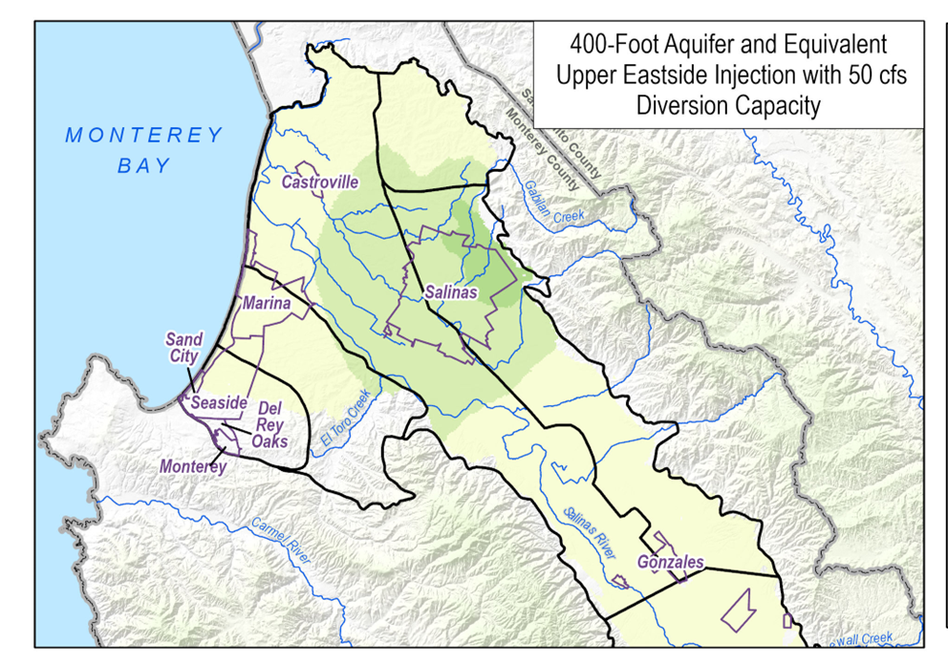
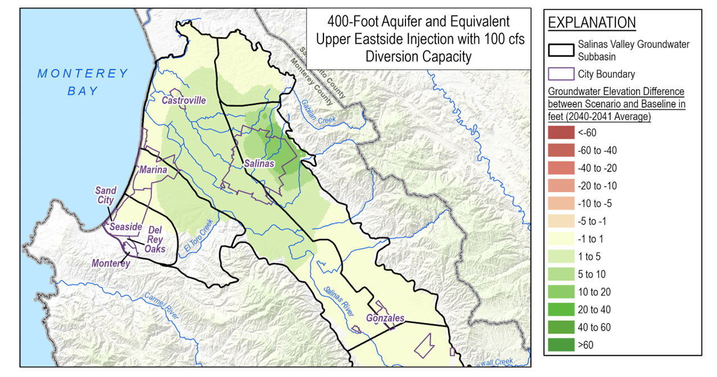
Effectiveness: Groundwater Levels – Eastside Injection
Groundwater Levels
Raises groundwater levels by up to 20 ft
MCWRA-SVBGSA Joint Workshop | May 18, 2026 | C&E Canals
Integrated Implementation Strategy

Slide 9
Questions & Discussion
Emily Gardner
Deputy General Manager, SVBGSA
gardnere@svbgsa.org
MCWRA-SVBGSA Joint Workshop | May 18, 2026 | C&E Canals
Integrated Implementation Strategy

