Slide 1
Brackish Groundwater Restoration Project (BGRP)
MCWRA-SVBGSA Joint Workshop on Groundwater Sustainability
May 18, 2026 | Integrated Implementation Strategy
Monterey County Water Resources Agency & Salinas Valley Basin Groundwater Sustainability Agency

Slide 2
Project Overview
BGRP installs a row of wells parallel to the coast to extract brackish water, treats it via reverse osmosis, and injects treated water into the 180 and 400-foot aquifers inland of the seawater intrusion front.
BGRP Injection Only, preferred scenario in the feasibility study, includes:
20 coastal extraction barrier wells (180/400-Ft)
Centralized 2-pass RO treatment facility
21 inland injection wells into 180/400-Ft Aquifers
MCWRA-SVBGSA Joint Workshop | May 18, 2026 | BGRP
Integrated Implementation Strategy

Slide 3
Scenarios Evaluated
1
BGRP
2
Alternative Water Supply Project
3
No Action Alternative
Extraction, Treatment, and Direct Deliveries Plus Injection – Small.
Extraction, Treatment, and Direct Deliveries Plus Injection – Medium.
Extraction, Treatment, and Direct Deliveries Plus Injection – Large.
Extraction, Treatment, and Injection Only.
Extraction, Treatment, and Eastside Injection.
Extraction North of the Salinas River, Treatment, and Direct Deliveries Plus Injection.
Extraction From the 180-Foot Aquifer, Treatment, and Injection in the 400-Foot Aquifer.
Equivalent volume using surface water
Requires additional storage infrastructure
Higher unit cost ($5,836/AF)
Federal comparison requirement
Continued seawater intrusion advance
No engineered solution, only demand management
Assumes a 30% or 50% pumping reduction in one or more subbasins
Used to determine benefit-cost analysis for federal funding share as required for USBR Title XVI analysis
MCWRA-SVBGSA Joint Workshop | May 18, 2026 | BGRP
Integrated Implementation Strategy

Slide 4
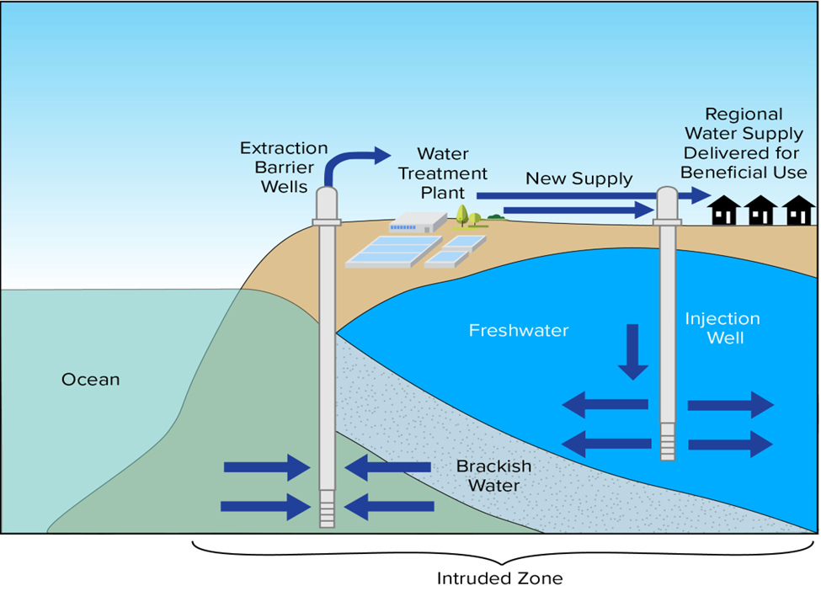
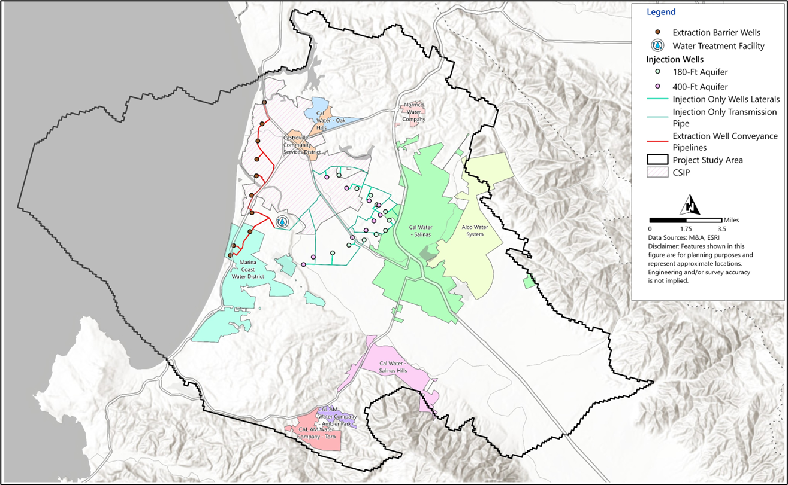
Project: BGRP Injection Only Scenario
MCWRA-SVBGSA Joint Workshop | May 18, 2026 | BGRP
Integrated Implementation Strategy

Slide 5
Key Findings
✓
Injection Only scenario identified as preferred project because most effective with least disruption to users (Oct 2025)
✓
Meets SWI minimum threshold by 2040; results in significant chloride mass reduction within seawater intruded area
✓
Meets cost benefit and cost effectiveness criteria for federal funding with a benefit-cost ratio of 1.41-2.34
Equivalent size AWSP using surface water or other sources more expensive due to amount of storage needed
✓
Drought-resilient – brackish groundwater source is independent of surface-water hydrology
✓
✓
Creates 46,900 AFY of new water supply; existing ag and urban wells and water systems continue operating
MCWRA-SVBGSA Joint Workshop | May 18, 2026 | BGRP
Integrated Implementation Strategy

Slide 6
Cost Estimates
$951M
$113M/yr
$3,321/AF
Capital Cost
Annual O&M Cost
Unit Cost
Cost Components
20 coastal extraction barrier wells (180/400-Ft)
Centralized 2-pass RO treatment facility
21 inland injection wells into 180/400-Ft Aquifers
Conveyance and outfall infrastructure
MCWRA-SVBGSA Joint Workshop | May 18, 2026 | BGRP
Integrated Implementation Strategy

Slide 7
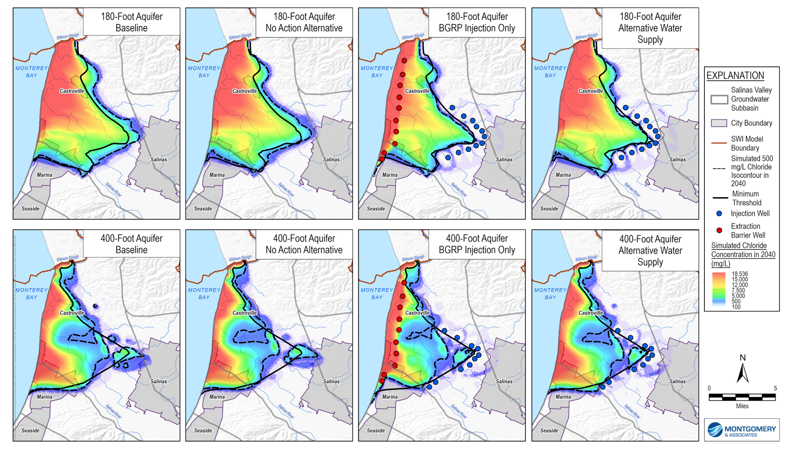
Effectiveness: Seawater Intrusion
Seawater Intrusion (SWI)
Halts and reverses SWI; meets minimum threshold by 2040
Significant chloride mass and SWI area reduction compared to alternatives
Only project studied that achieves SWI minimum threshold
MCWRA-SVBGSA Joint Workshop | May 18, 2026 | BGRP
Integrated Implementation Strategy

Slide 8
Effectiveness: Groundwater Levels
Groundwater Levels
Injection of 46,900 AFY raises GW levels over 60 ft near injection wells
Capture of incoming seawater lowers GW levels at the coast
MCWRA-SVBGSA Joint Workshop | May 18, 2026 | BGRP
Integrated Implementation Strategy

Slide 9
Questions & Discussion
Sarah Hardgrave
Deputy General Manager, SVBGSA
hardgraves@svbgsa.org
MCWRA-SVBGSA Joint Workshop | May 18, 2026 | BGRP
Integrated Implementation Strategy

