Slide 1
Aquifer Storage and Recovery (ASR)
MCWRA-SVBGSA Joint Workshop on Groundwater Sustainability
May 18, 2026 | Integrated Implementation Strategy
Monterey County Water Resources Agency & Salinas Valley Basin Groundwater Sustainability Agency

Slide 2
Project Overview
ASR addresses seawater intrusion in the 180/400-Foot Aquifer Subbasin by maximizing surface water diversion, injecting treated surface water to raise groundwater elevations, and reducing pumping. Project concepts include:
Shift SRDF diversion season or construct new diversion
New surface water treatment and conveyance to ASR wells
ASR or injection only wells, recovery by CSIP wells
MCWRA-SVBGSA Joint Workshop | May 18, 2026 | ASR
Integrated Implementation Strategy

Slide 3
Scenarios Evaluated
1
Wet Season Releases to SRDF with ASR
2
New Diversion: ASR in Both Aquifers
3
New Diversion: 400-Ft Injection Only
Shift SRDF diversion to capture winter flows
Inject into 180-Ft and 400-Ft Aquifers
Recover stored water for CSIP in growing season
Requires reservoir operational changes
New diversion facility for winter high flows
SRDF/CSIP operates as usual Apr-Oct
Inject in 180-Ft and 400-Ft Aquifers
Requires new/modified water right
New diversion of winter high flows
Injection only in 400-Ft Aquifer
No extraction from ASR wells
Targets deeper aquifer recharge
MCWRA-SVBGSA Joint Workshop | May 18, 2026 | ASR
Integrated Implementation Strategy

Slide 4
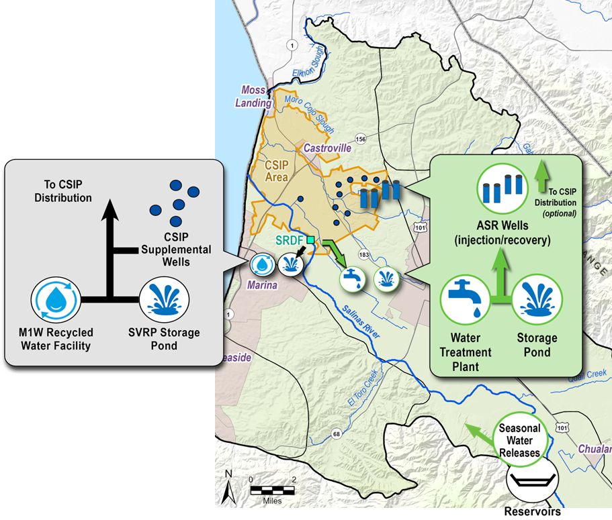
Project: Wet Season Releases to SRDF with ASR
MCWRA-SVBGSA Joint Workshop | May 18, 2026 | ASR
Integrated Implementation Strategy

Slide 5
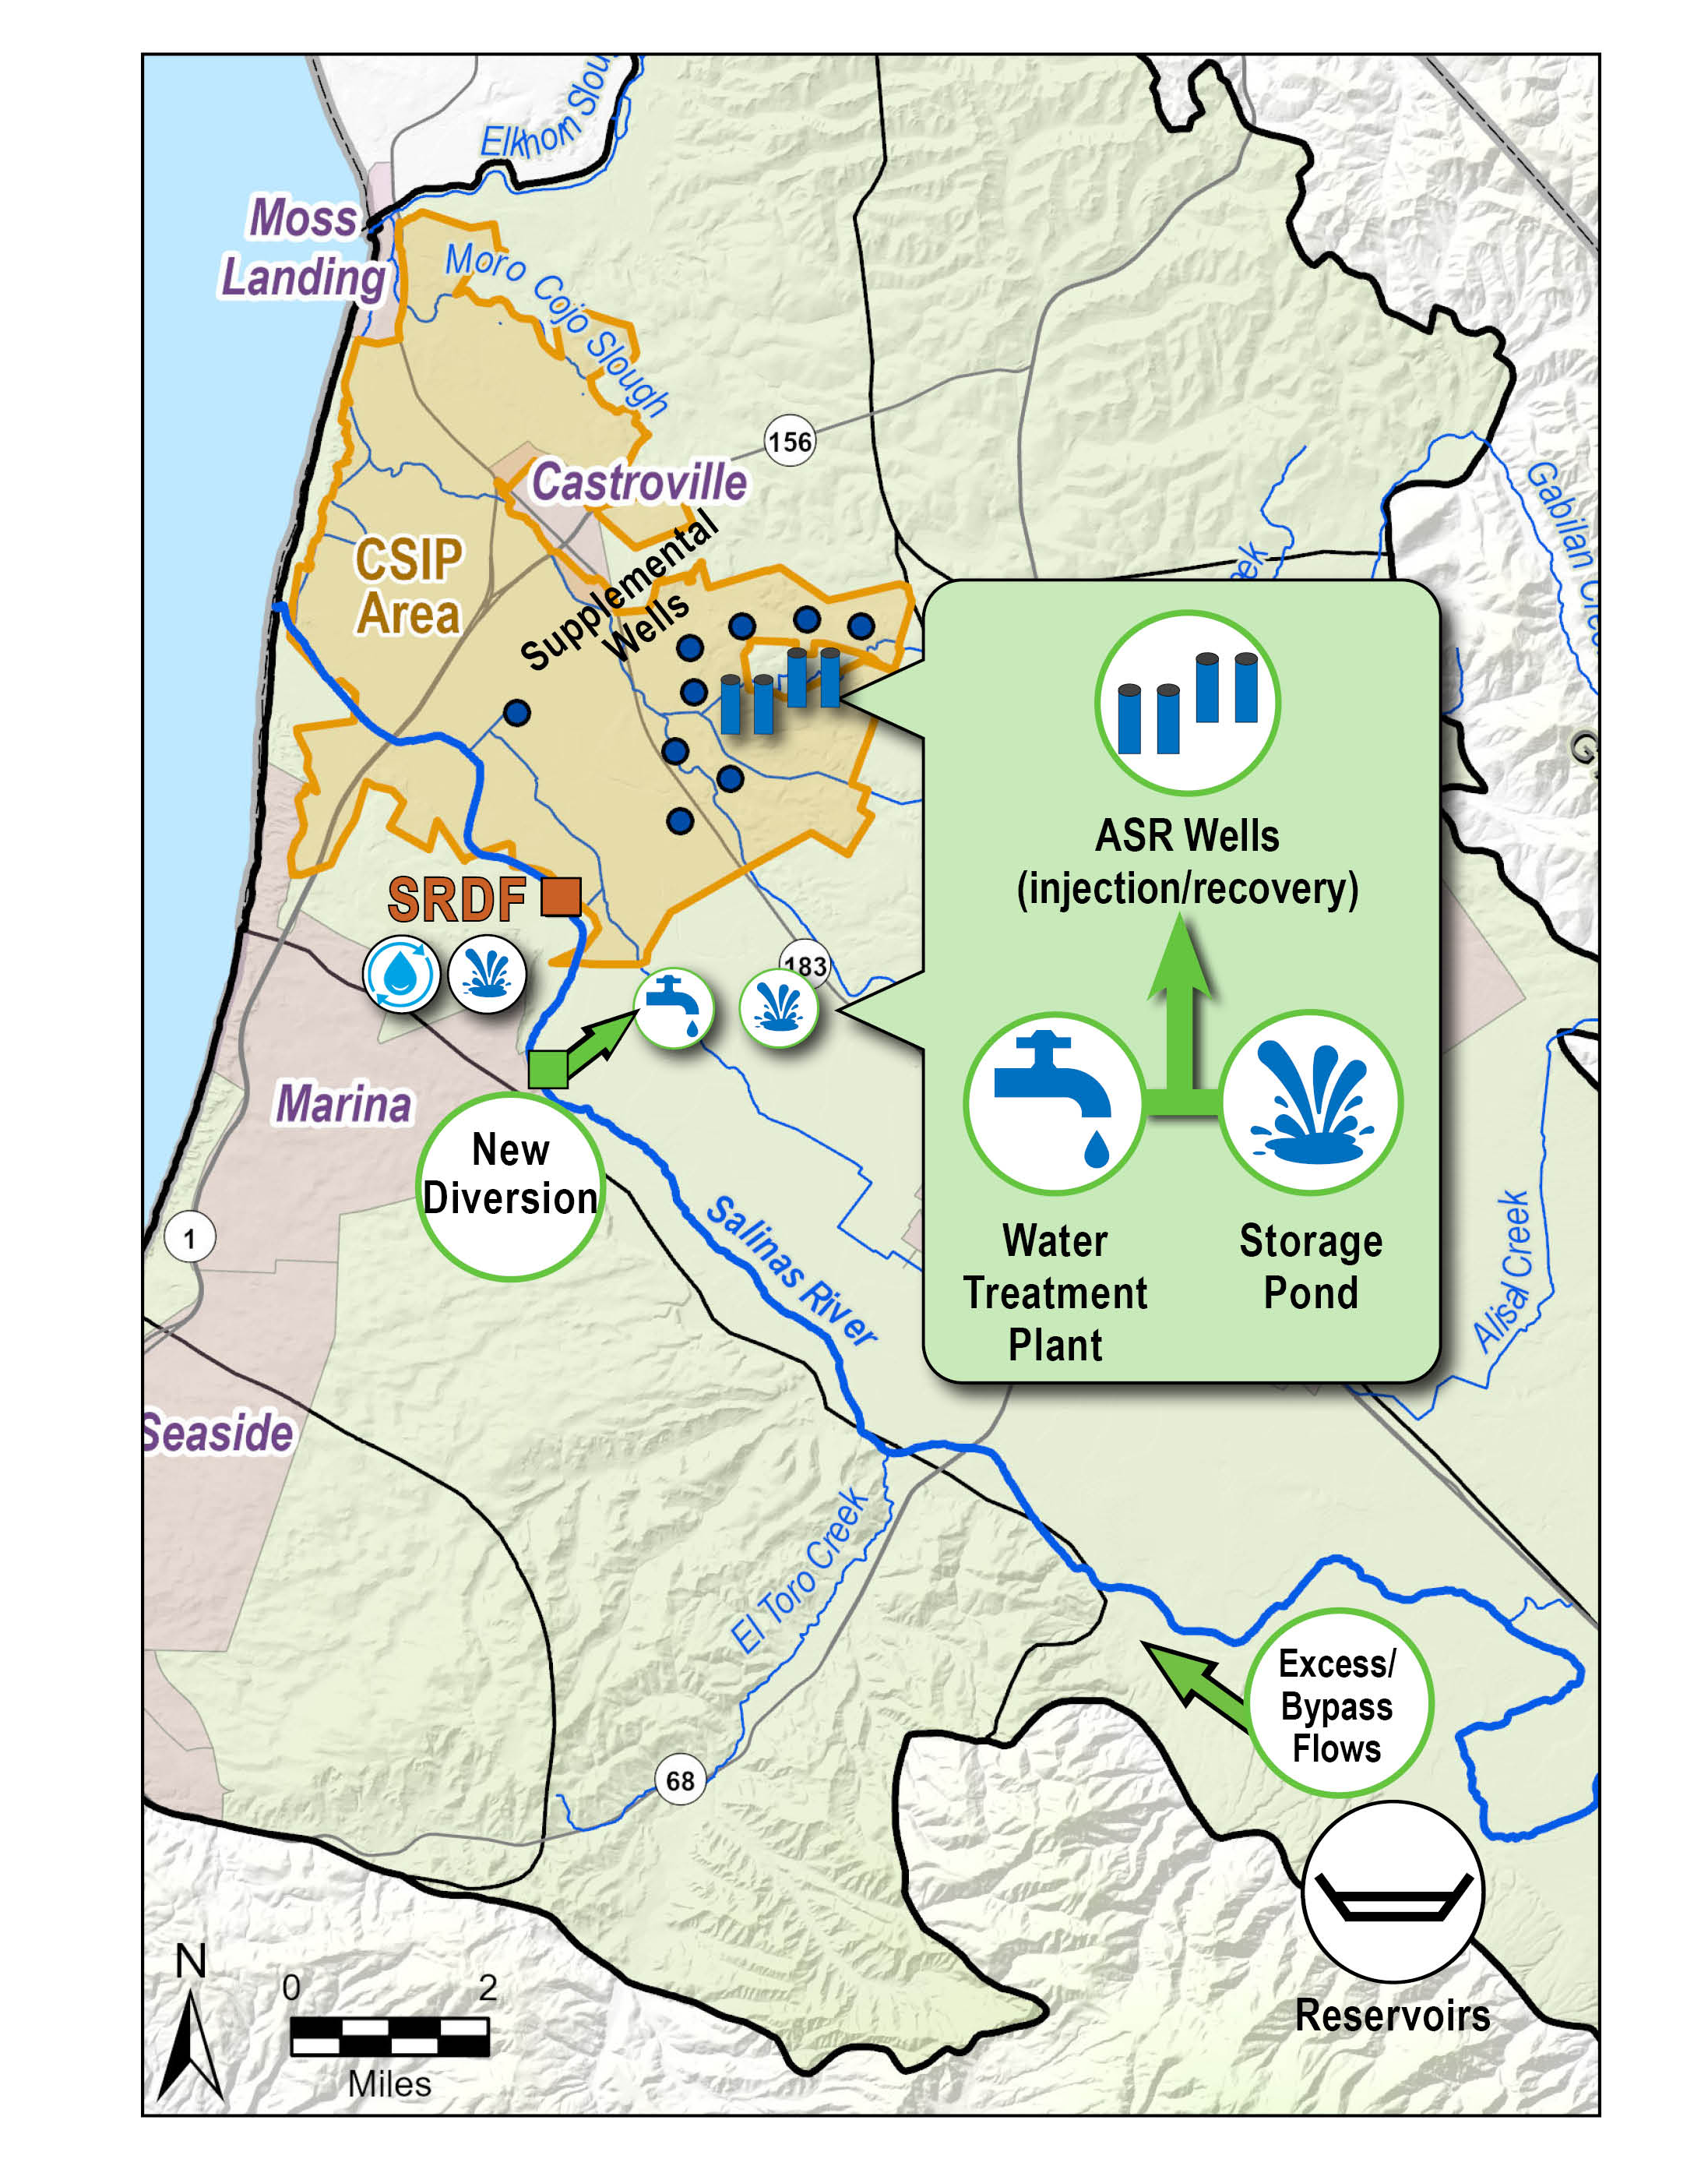
Project: New Diversion of Winter High Flows for ASR
MCWRA-SVBGSA Joint Workshop | May 18, 2026 | ASR
Integrated Implementation Strategy

Slide 6
Key Findings
✓
Significant physical and regulatory constraints with reservoir and SRDF operations to capture higher flows during wet season
✓
Modest increases in groundwater levels near injection, but does not achieve SWI minimum threshold
✓
Modified SRDF water right or new water right needed
✓
Existing CSIP and SRDF infrastructure upgrades needed
Existing CSIP and SRDF infrastructure upgrades needed
✓
Diversion of of 6,700 AFY to 12,900 AFY estimated for treatment and injection
MCWRA-SVBGSA Joint Workshop | May 18, 2026 | ASR
Integrated Implementation Strategy

Slide 7
Cost Estimates
$278M-$383M
$5M-$9M/yr
$1,781-$2,269/AF
Capital Cost
Annual O&M Cost
Unit Cost
Cost Components
New diversion facility or SRDF modifications
Surface water treatment plant
ASR/injection well network (16+ wells)
MCWRA-SVBGSA Joint Workshop | May 18, 2026 | ASR
Integrated Implementation Strategy

Slide 8
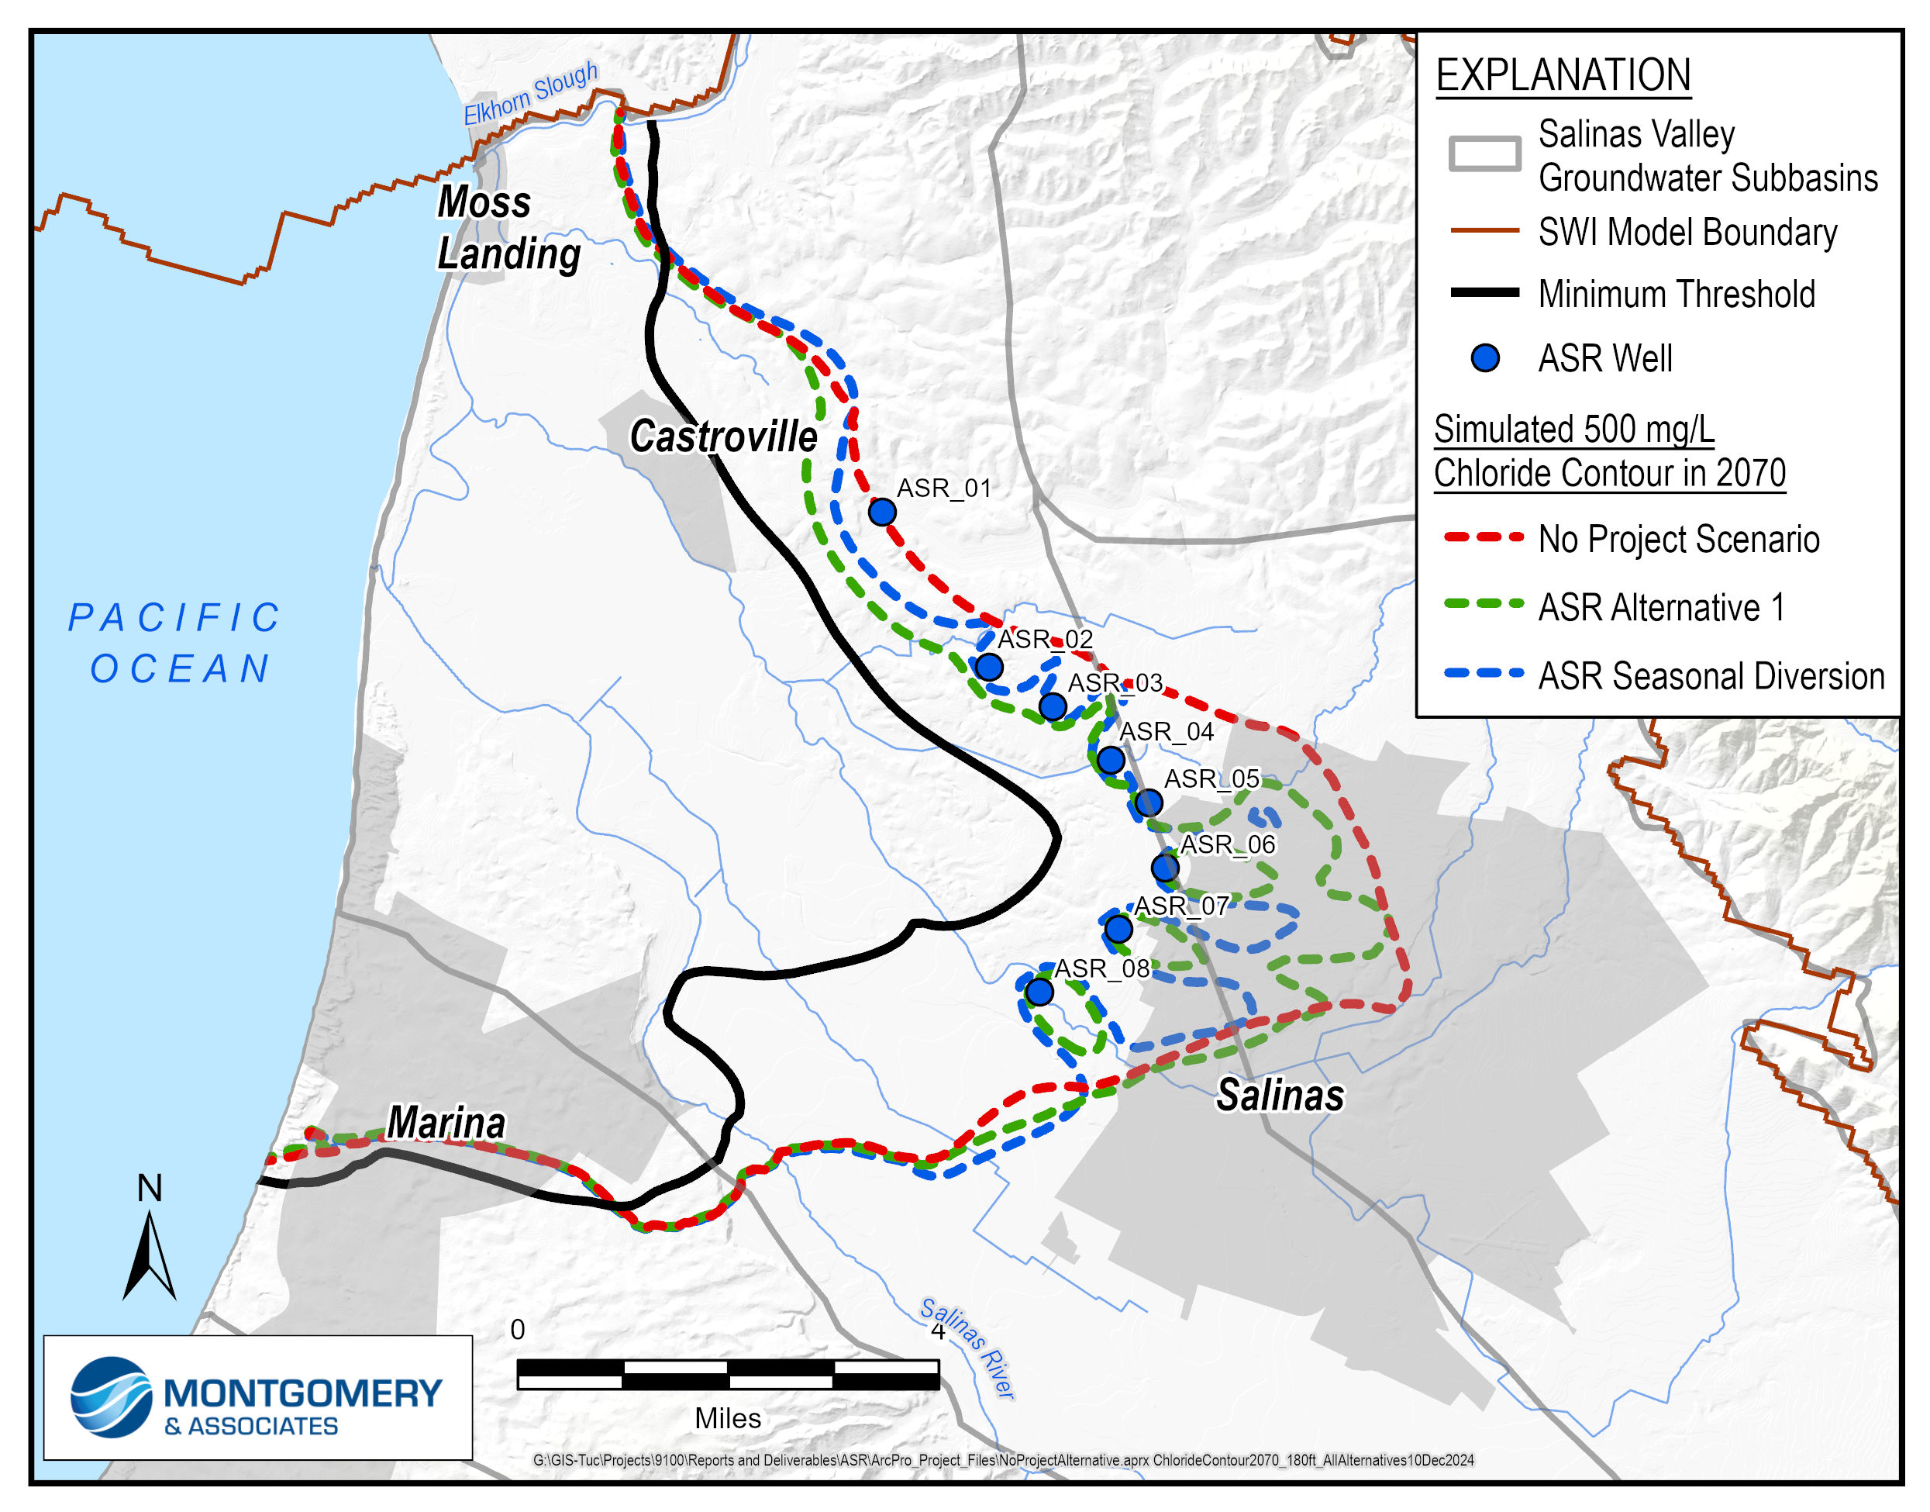
Effectiveness: Seawater Intrusion
Seawater Intrusion (SWI)
[SWI modeling results map / chloride concentration comparison]
Raises hydraulic gradient near injection wells but SWI passes through in between them
Neither scenario achieves SWI minimum threshold
Some improvement near City of Salinas
MCWRA-SVBGSA Joint Workshop | May 18, 2026 | ASR
Integrated Implementation Strategy

Slide 9
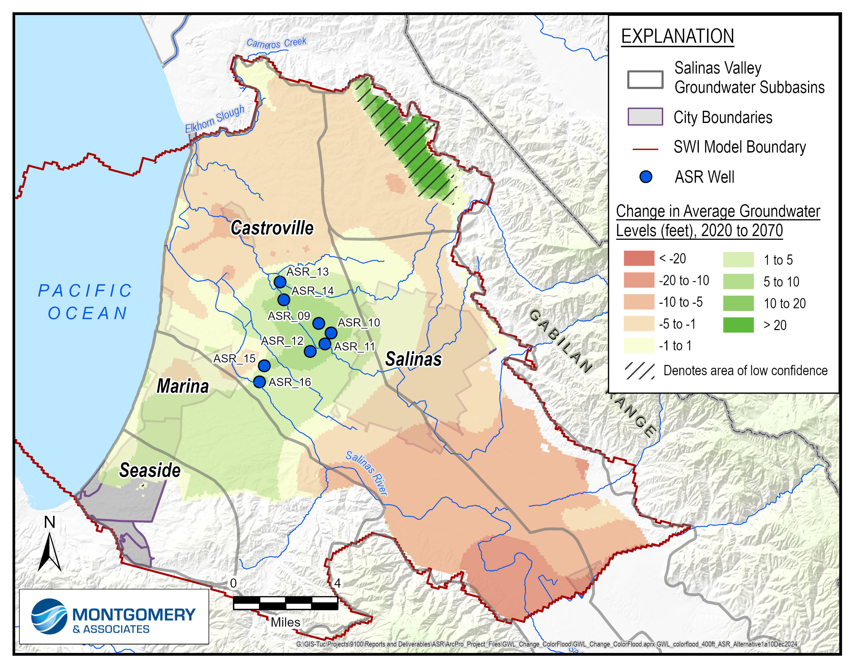
Effectiveness: Groundwater Levels
Groundwater Levels
Raises GW elevations near injection wells, but not enough to get above sea level
Localized GW improvements near ASR wells
MCWRA-SVBGSA Joint Workshop | May 18, 2026 | ASR
Integrated Implementation Strategy

Slide 10
Questions & Discussion
Sarah Hardgrave
SVBGSA Deputy General Manager
hardgraves@svbgsa.org
MCWRA-SVBGSA Joint Workshop | May 18, 2026 | ASR
Integrated Implementation Strategy

