Slide 1

- DEMAND MANAGEMENT -
Planning For Uncertainty
Monterey Subbasin Committee
Survey Results
December 18, 2024
Dave Ceppos
Process Facilitator
Notes:
Font: Corbel

Slide 2
Survey Review
10 responses out of 10 members
14 Questions
Focus on:
  Uncertainty Conditions
  Past Impacts and Actions
  Feasibility / Infeasibility of Demand Management Options
  Information Needs

Slide 3
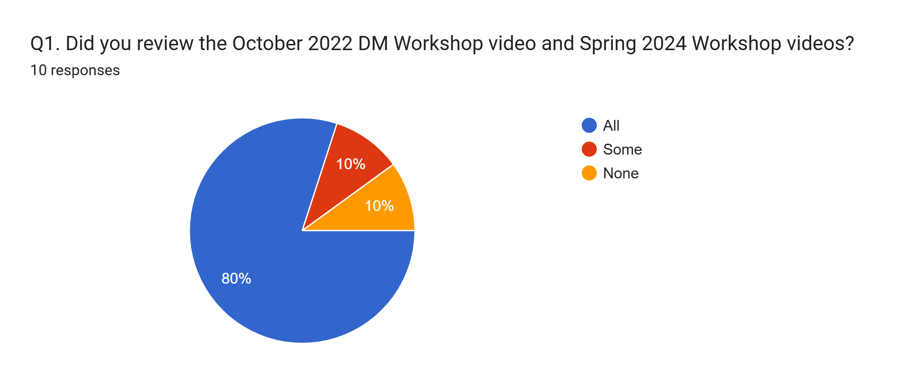
Survey Results

Slide 4
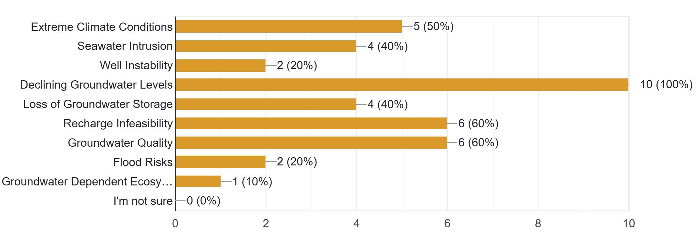
Survey Results
Q2 What uncertainty conditions apply most to your subbasin?

Slide 5
Survey Results
Q3. Have any of these conditions caused negative impacts to groundwater users in your subbasin?
  Groundwater Quality (5 of 10)
    Arsenic Levels (4 of the 5)
  Declining Groundwater Levels (5 of 10)
    Well Production
    Well Instability and Replacement
  Recharge Infeasibility (2 of 10)
  Seawater Intrusion (2 of 10)

Slide 6
Survey Results
Q3. Continued
  Governmental/Regulatory Implications / Politics (3 of 10)
    County Planning Ordinances Re; land use / landscapes
    Consolidation of/water management by private water companies
    General governmental imposition
  No Impacts Observed (1 of 10)

Slide 7
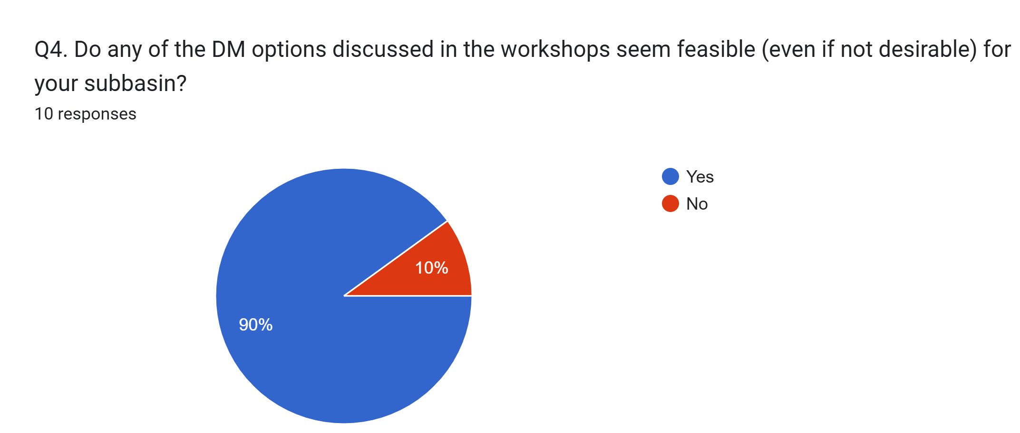
Survey Results

Slide 8
Survey Results
Q5. If so, which options and why do they seem feasible?
  Enhanced Urban Efficiencies / Conservation (6 of 10)*
  Water Use Data and Education (4 of 10)
  Residential Water Capture (2 of 10)*
  Tiered Allocations
  Enhanced Agricultural Practices
  Fallowing / Land Retirement
  All (with caveats about new water supply)
  None are feasible
    *noted that this may not produce enough benefits to achieve sustainability

Slide 9
Survey Results
Q6. Regarding options you didn’t list as feasible, why do you consider them infeasible?
  Not applicable to subbasin water use conditions
    Principally domestic
    Lack of metering doesn’t support extraction fees
    Recharge not appropriate or scalable
    Land management not appropriate or scalable
  Several options will create more government oversight
    Bureaucracy
    Higher taxes/fees = Higher food costs

Slide 10
Survey Results
Q7. In addition to ROI what would you need to know to make more informed recommendations?
  Cost/Benefit Analysis of options
  Modelling of options and impacts to water use / sustainability
  Local willingness / ability to pay
  Availability of/ competition for external funding to augment local ability to pay
  Impacts to end users / Equity of impacts
  Consistency with Cal Water conservation plans

Slide 11
Survey Results
Q8. Are there uncertainty conditions that could require water use reduction by urban and/or agricultural users in your subbasin
  Primary Response - Drought and climate related impacts
  Other Responses
    Governmental choices
    Maintenance of / failure of water systems / wells
    Continued groundwater level depletion
    Impacted groundwater quality
    Increased population / land development

Slide 12
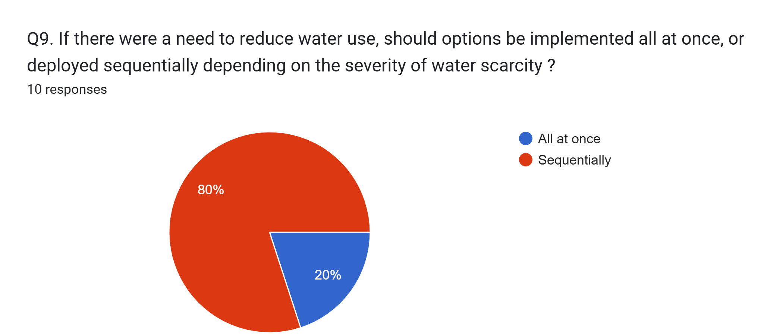
Survey Results

Slide 13
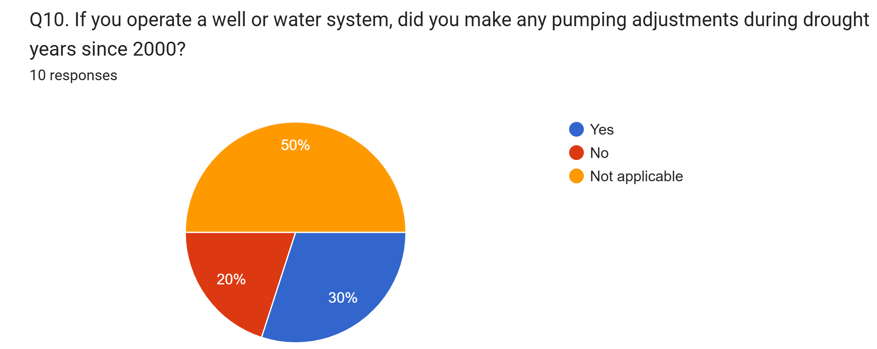
Survey Results

Slide 14
Survey Results
Q11. If you made pumping adjustments, please describe
  Implemented a water shortage contingency plan that has escalating voluntary then mandatory demand/consumption reductions
  As part owner of two small water systems, we watch all water use very carefully.

Slide 15
Survey Results
Q12. Do you use water efficiency measures? If so, please describe
  Primary Response – Water Conservation
    Drought tolerate landscaping
    Landscape irrigation practices
    Interior conservation practices
    Low water use appliances
  No measures used

Slide 16
Survey Results
Q13. Are there other water efficiency measures you would like to deploy?
  Interest in innovative agricultural irrigation practices
  Domestic rain capture
  Above ground reservoirs
  Water metering / Water use data / Water use education
  Water rate adjustments to prohibit excessive use

Slide 17
Survey Results
Q14. Thinking about the recent committee presentations on groundwater conditions in the Corral de Tierra Management Area, are there additional thoughts you would like to share?
  Need a regional solution that involves the whole valley.
  Need to learn from regional examples / successes. Create a shared sense of purpose to solve groundwater problems. Focus on innovation.
  Significant need to inform water users of groundwater issues and convince Monterey County Housing and Community Development to consider groundwater issues when considering permits.
  Need focus and success on Brackish Water Restoration Project
  Better understand the recharge capabilities of our subbasin and how projects may improve our situation, if at all.
  Corral Management Area seems to be a logical focus

Slide 18
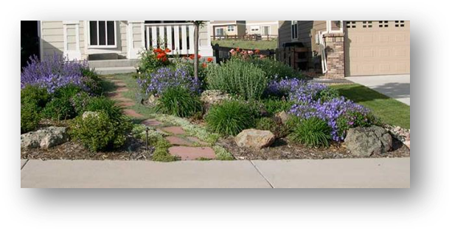
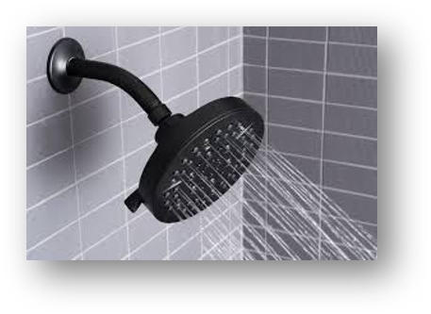

Urban Conservation
LOW-COST ACTIONS
Water savings come from individuals investing in new practices/ technology
  Permanent
  Voluntary for individuals - likely obligatory for municipalities
  Low cost
  Recurring, but low benefit every year
Notes:
Urban is a small percentage of the overall water use. As you heard, lots has already been done, so future benefit may be marginal

Slide 19
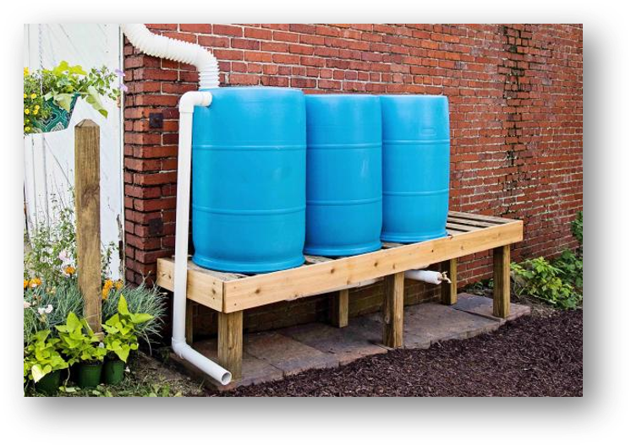
Decentralized Residential Water Capture
LOW-COST ACTIONS
Water savings come from individuals storing rainwater for non-potable use
  Permanent
  Voluntary
  Low cost
  Recurring, but low benefit every year
Notes:
Can’t do this in all states, such as Colorado

Slide 20
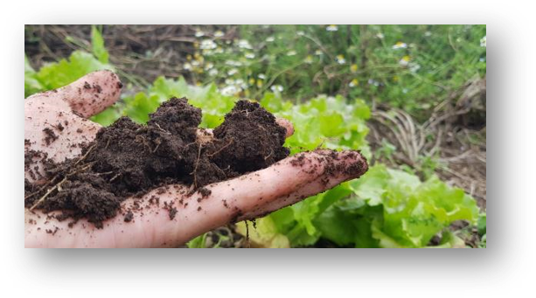
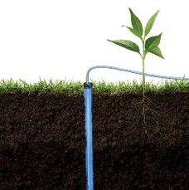
Promote Best Agricultural Practices
LOW-COST ACTIONS
Water savings come from individuals investing in new practices or technologies
  Permanent
  Voluntary
  Low cost
  Recurring, but low benefit every year
Notes:
already heard some ag practices from Norm, and Brian will present more in an upcoming talk.

Slide 21
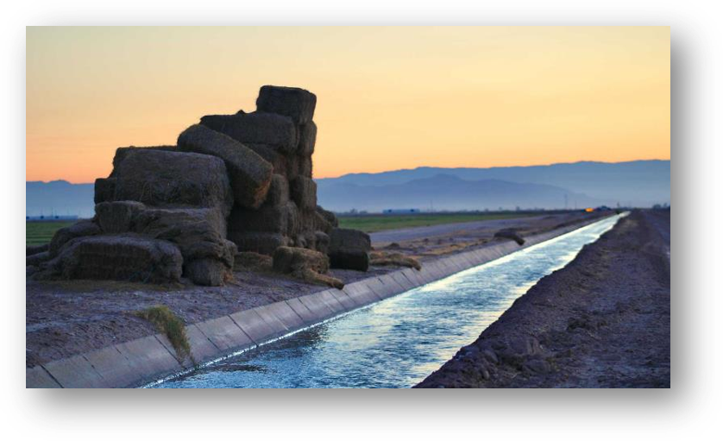
Limit Place of Use
LOW-COST ACTIONS
Water savings come from limiting how far water can be moved
  Temporary or Permanent
  Obligatory
  Low to Medium cost
  Recurring benefit every year

Slide 22
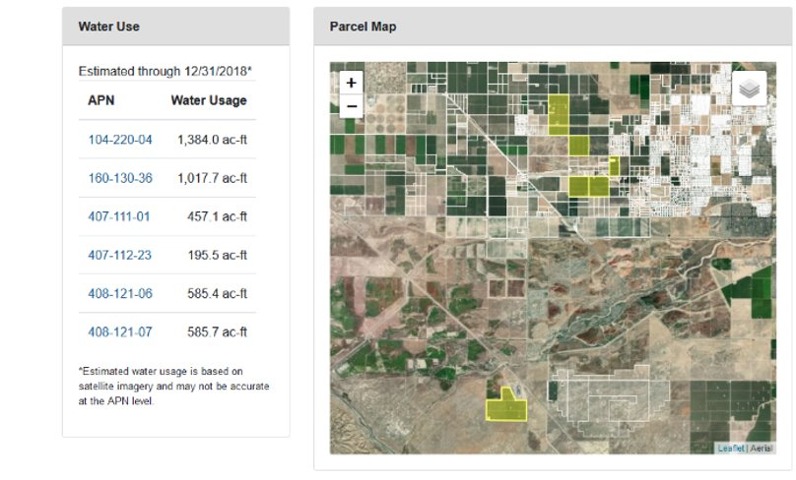
Provide Water-Use Data
Water savings come from individuals assessing their individual water use, and increasing efficiency
  Permanent
  Voluntary
  Medium cost to implement and maintain
  Likely recurring benefit every year
MEDIUM-COST ACTIONS
Notes:
Provide any data we can about where your water comes from and how much is used. Includes rainfall, river diversions (if any), pumped groundwater, crop et

Slide 23
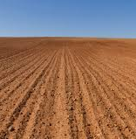
Fallowing Options
Agricultural land is idled
Groundwater is not pumped for irrigation
Land must still be managed
Various, related options
MEDIUM-COST ACTIONS
Notes:
We realize this is controversial. One of our messages is that strategic planning now could minimize the need for or level of fallowing. But if we plan now, we can be nimble later, and maybe avoid fallowing. But we need to know both what our options are, and what consequences might be if we don’t plan adequately

Slide 24
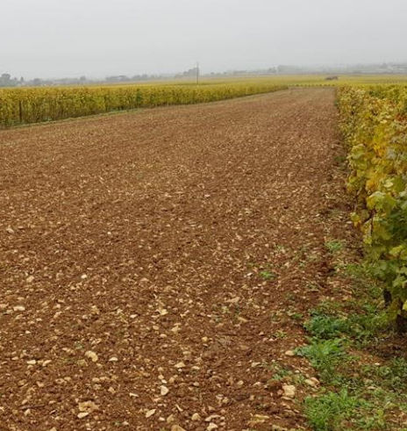
Delay Crop Replacement
Water savings come from occasionally fallowing fields before crops are replaced
  Temporary or permanent policy
  Voluntary
  Low cost to public, medium cost to individual growers
  Variable and likely low, benefit every year
MEDIUM-COST ACTIONS

Slide 25
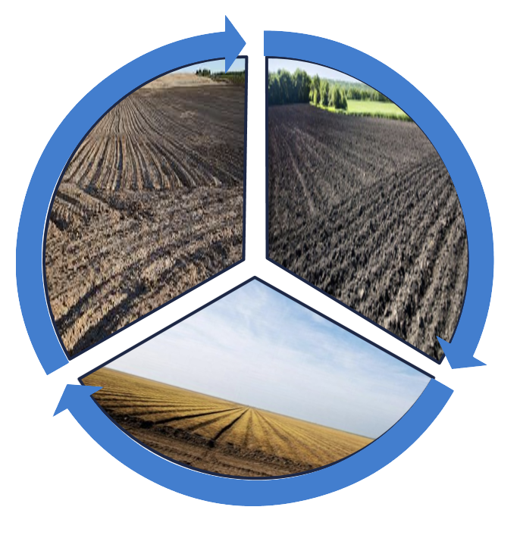
Rotational Fallowing
Water savings come from resting different fields on a rotating basis
  Permanent
  Obligatory
  Low cost to public, medium cost to individual growers
  Recurring benefit every year
MEDIUM-COST ACTIONS

Slide 26
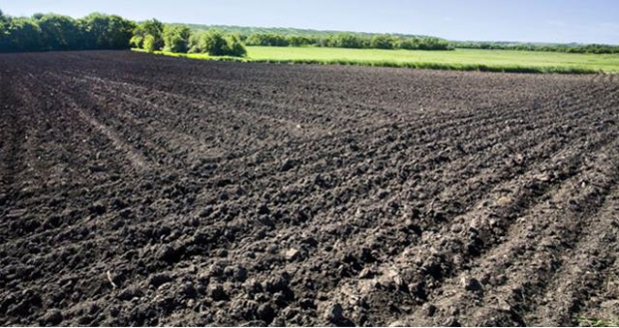
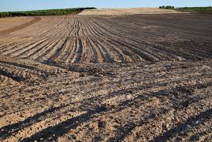
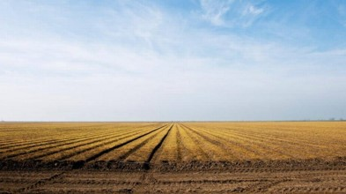

Fallow Bank
Water savings come from resting different fields on a rotating basis. All growers fund a “bank” that reimburses fallowing costs.
  Temporary or Permanent
  Voluntary fallowing
  Medium cost to public and individual growers
  Variable benefit every year
MEDIUM-COST ACTIONS

Slide 27
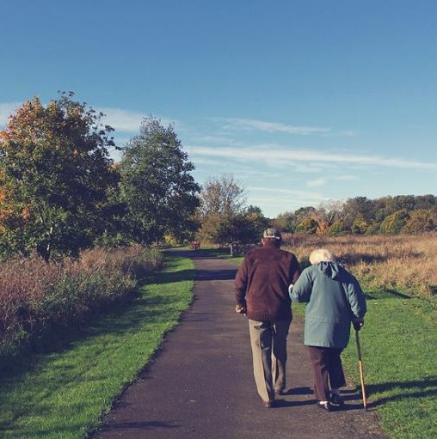
HIGH-COST ACTIONS
Repurpose/Retire Agricultural Land
Water savings come from permanently stopping irrigation on certain parcels
  Permanent
  Voluntary
  High cost – land must be bought or otherwise be compensated for
  Recurring and benefit every year

Slide 28
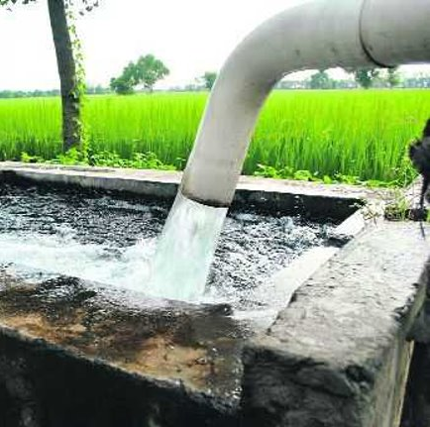
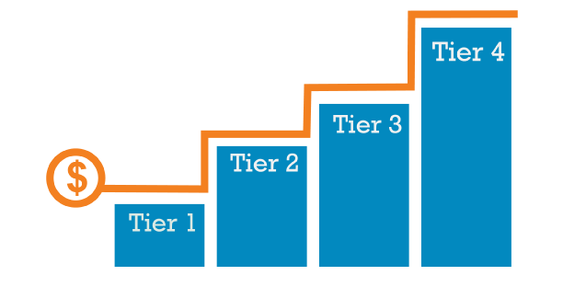
HIGH-COST ACTIONS
Tiered Extraction Fees
Water savings come from economic incentive to reduce water use
  Permanent or Temporary (but difficult)
  Obligatory
  High cost for managing program
  Recurring and potentially high benefit every year
Notes:
This can be an incentive to reduce water or a penalty. Explain idea of tiers

